Slide 1
A Technical Seminar Presentation
on
Decoding Emotions: A Dive into Sentiment Analysis
Submitted to the
JAWAHARLAL NEHRU TECHNOLOGICAL UNIVERSITY HYDERABAD
In partial fulfilment of the requirement for the award of the degree of
BACHELOR OF TECHNOLOGY
IN
COMPUTER SCIENCE AND ENGINEERING (DATA SCIENCE)
BY
PASNOOR SHREYA(20WJ1A6746)
Under the Esteemed Guidance of
Mr. Ch. Srinivas, Asst. Professor
GURU NANAK INSTITUTIONS TECHNICAL CAMPUS (AUTONOMOUS)
School of Engineering and Technology
Ibrahimpatnam, R.R District 501506
2023-2024

Slide 2

CONTENTS
Abstract
Introduction
Applications
Advantages
Disadvantages
Existing Techniques
Hardware Requirements
Software Requirements
Future Scope
Conclusion

Slide 3
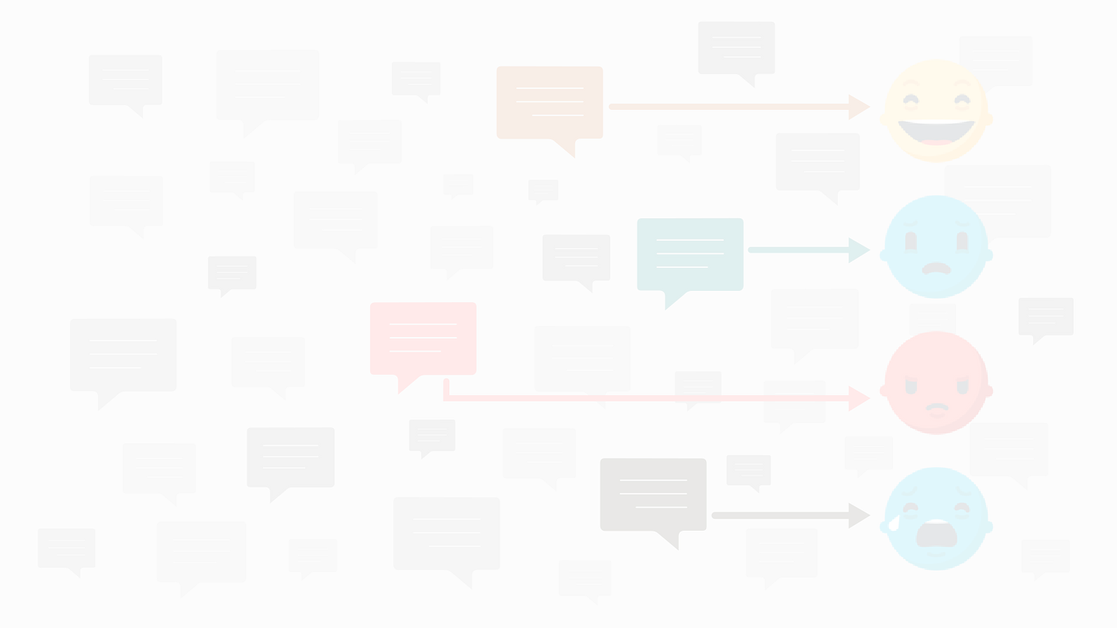
ABSTRACT
Sentiment analysis focuses on extracting and understanding emotions expressed in text.
This presentation provides a concise overview of sentiment analysis, exploring its significance in today's digital age.
We explore how sentiment analysis techniques decode the emotional tone of language, offering valuable insights for businesses, decision-makers, and researchers.

Slide 4
INTRODUCTION
Sentiment analysis, also known as opinion mining, is a technique used to determine the sentiment or emotion expressed in a piece of text.
It involves analyzing text data to identify and categorize the sentiment as positive, negative, or neutral.
Sentiment analysis has become increasingly important in various industries due to its ability to extract valuable insights from large volumes of textual data.

Slide 5
APPLICATIONS
Customer Feedback Analysis: Analyzing customer reviews on an online store.
Social Media Monitoring: Tracking sentiment on social media platforms for a brand's hashtag.
Brand Monitoring: Monitoring online discussions and reviews about a brand to assess overall sentiment.
Market Research: Analyzing social media discussions around a new technology to gauge public interest and potential market adoption.
Employee Feedback Analysis: Assessing sentiments in employee surveys to understand overall job satisfaction.

Slide 6
ADVANTAGES
Customer Insight
Improved Customer Service
Brand Monitoring
Competitor Analysis
Product Improvement

Slide 7
DISADVANTAGES
Ambiguity and Context
Sarcasm and Irony Recognition
Data Quality Issues
Privacy Concerns
Algorithm Bias
Impact of Negation

Slide 8
EXISTING TECHNIQUES
-Two Main Approaches
Rule-Based:
Lists of positive and negative words (lexicons) are used to classify sentiment.
Easy to set up but limited in accuracy for complex text.
Machine Learning:
Trains on labeled data (text with known sentiment) to classify new text.
More accurate but requires a lot of data and can be complex to implement.
Choosing the Right Technique
Consider the complexity of your text data.
Think about the amount of data you have available.

Slide 9
HARDWARE REQUIREMENTS
Processor (CPU):
For small to medium-scale projects - a modern multi-core CPU
Large-scale projects - high-performance CPUs
Memory (RAM):
8GB RAM or more is recommended for handling moderate-sized datasets.
Larger datasets or complex models may require 16GB or higher.
GPU (optional):
Deep learning models, especially those based on neural networks, can benefit from Graphics

Slide 10
SOFTWARE REQUIREMENTS
Operating System:
Sentiment analysis tools and libraries are generally compatible with major operating systems, including Windows, macOS, and Linux.
Python:
Python is a popular programming language for sentiment analysis. Ensure you have the latest version installed.
Libraries and Frameworks:
For machine learning: scikit-learn, TensorFlow, PyTorch.
For natural language processing: NLTK, spaCy.
For deep learning: Keras, TensorFlow, PyTorch.

Slide 11
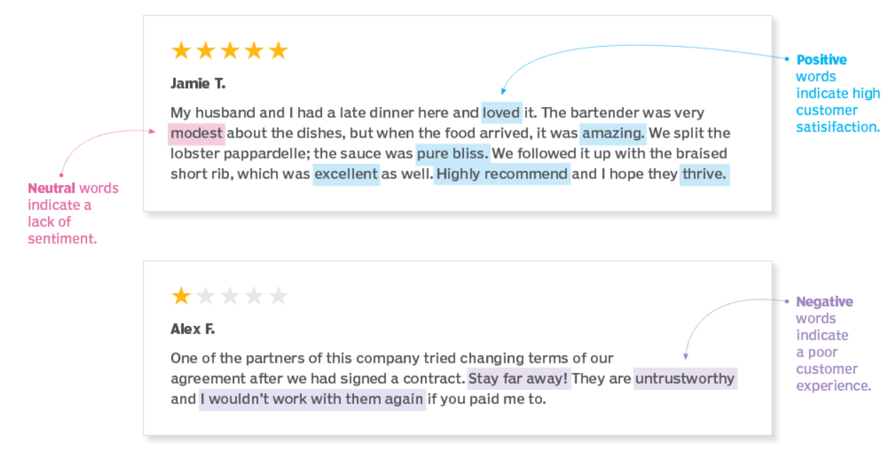
WORKING PROCEDURE
Collect Data
Clean the Data
Extract Features
Choose an ML Model
Sentiment Classification

Slide 12
FUTURE SCOPE
Deeper Understanding of Emotions
Multimodal Sentiment Analysis
Explainable AI for Sentiment Analysis
Integration with Other Technologies
Ethical Considerations

Slide 13
CONCLUSION
In conclusion, sentiment analysis offers a powerful lens into customer feelings. By leveraging this technology, we can gain valuable insights to improve products, target marketing efforts, and provide exceptional customer service. As the field continues to evolve, we can expect even deeper emotional understanding and seamless integration with other technologies. The future of sentiment analysis is bright, promising to revolutionize how businesses connect with their customers.

Slide 14

THANK YOU

